Slide 1
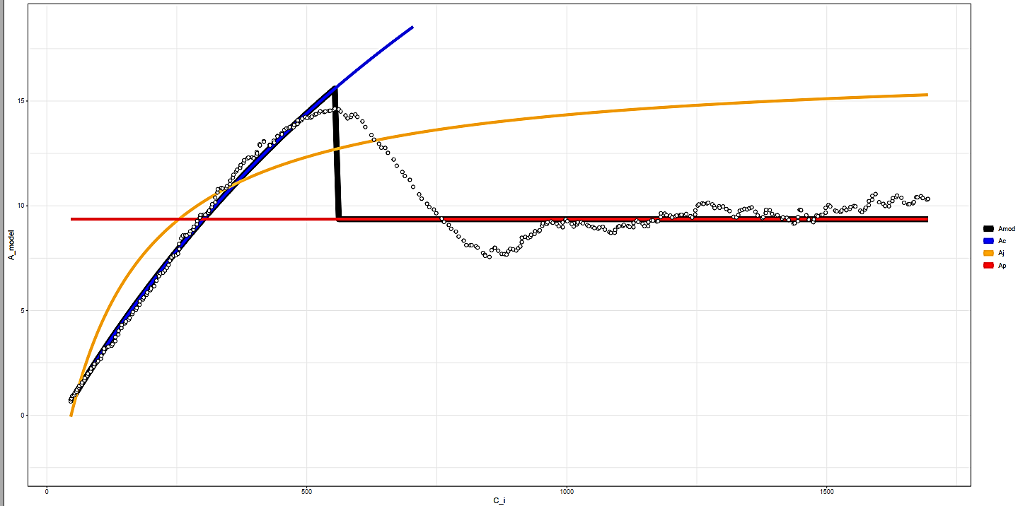

K6706L1
15
10
Modeled A
5
Amod
Ac
Aj
Ap
0
0
500
1000
1500
$$C_{i}$$

Slide 2
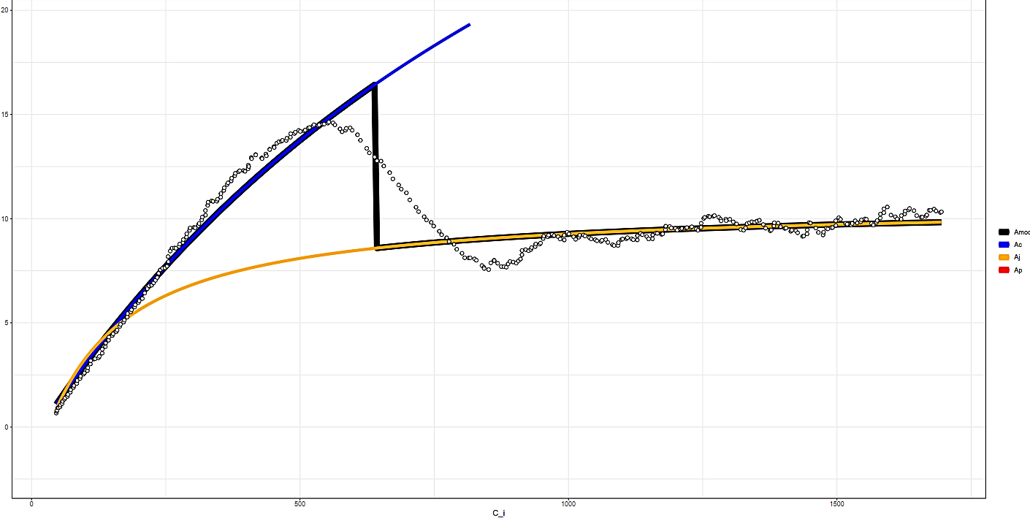

K6706L1
15
10
Modeled A
5
Amod
Ac
Aj
Ap
0
0
500
1000
1500
$$C_{i}$$

Slide 3
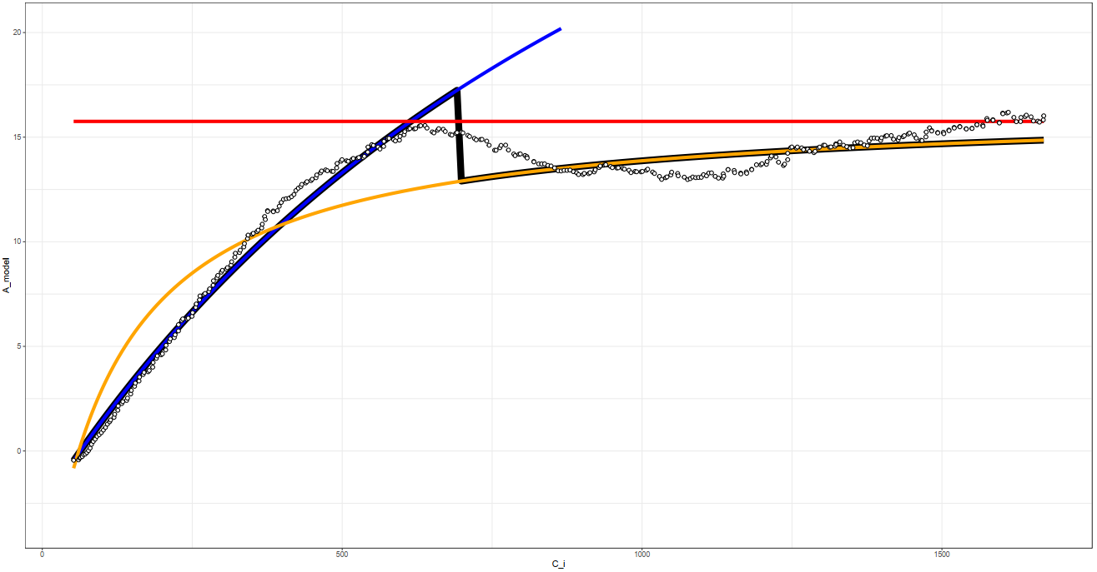

K6706L2
20
15
Modeled A
10
5
Amod
Ac
Aj
Ap
0
0
500
1000
1500
$$C_{i}$$

Slide 4
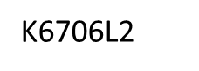
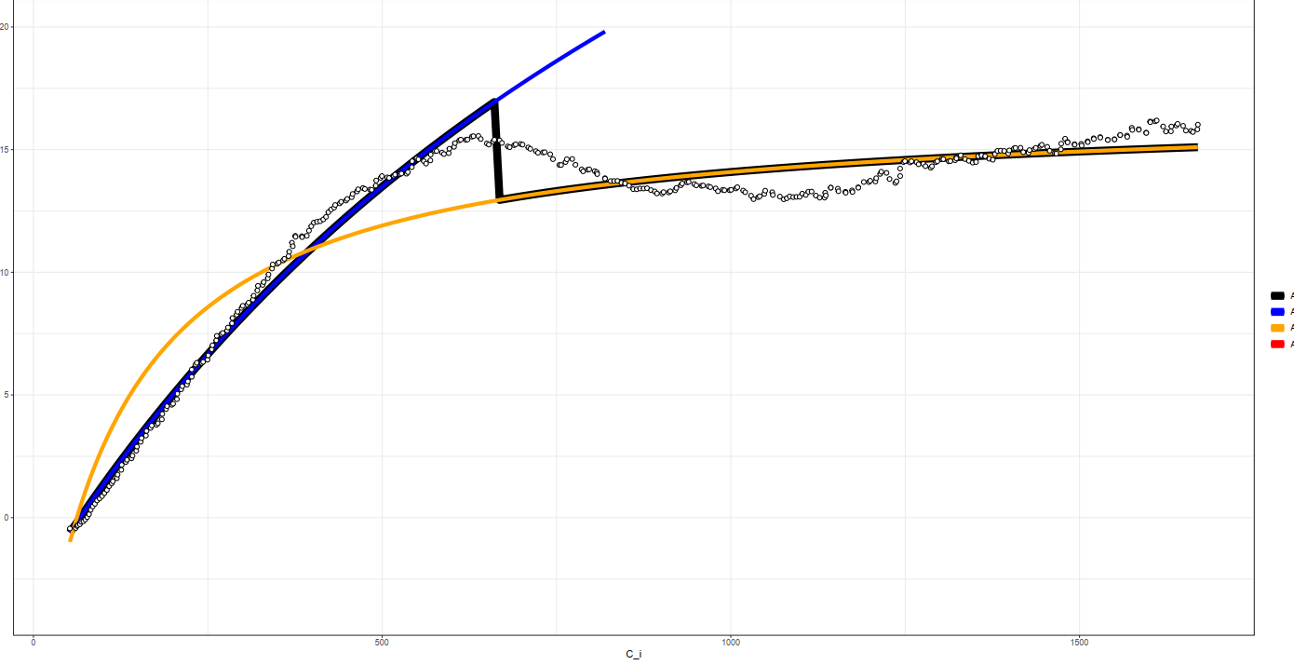
20
15
Modeled A
10
5
Amod
Ac
Aj
Ap
0
0
500
1000
1500
$$C_{i}$$

Slide 5
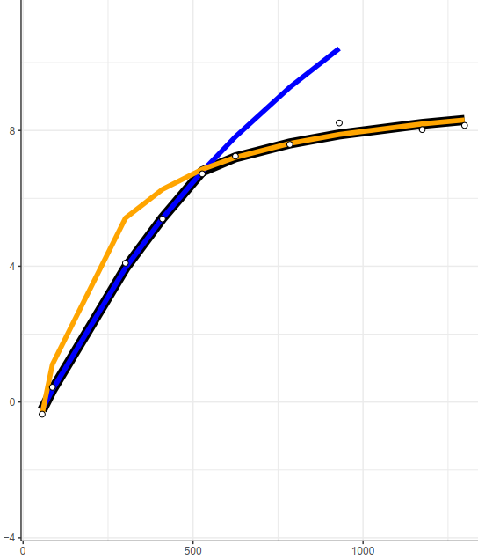
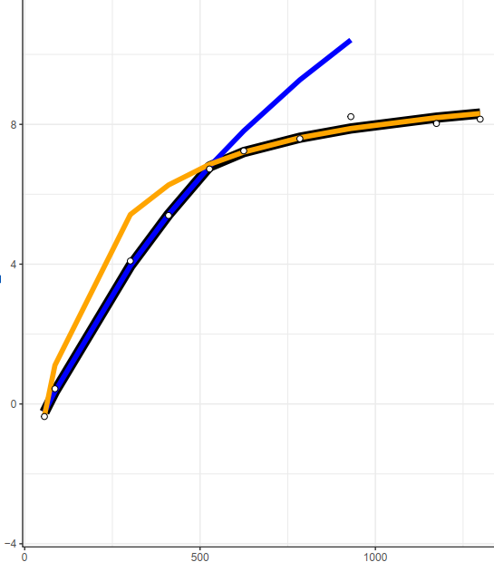
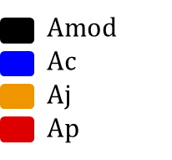
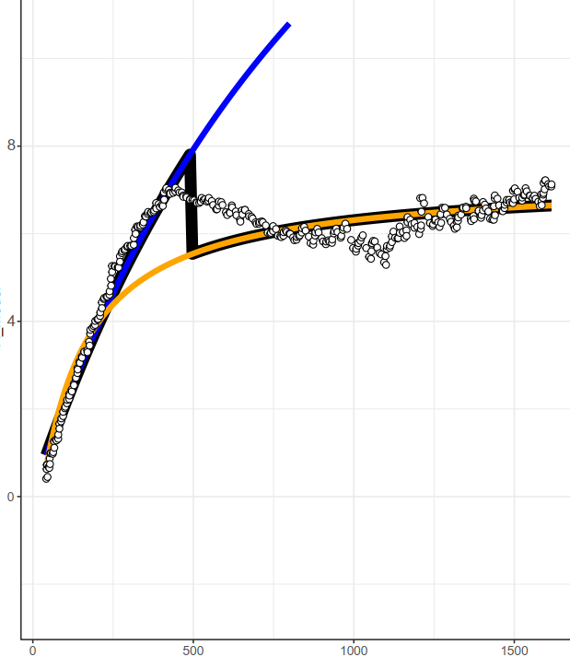
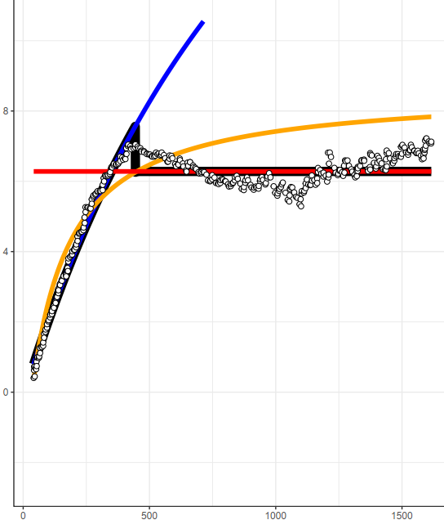


Couratari stellata, Leaf 1
Without TPU
With TPU
Steady-State
Modeled A
DAT
Modeled A
$$C_{i}$$
$$C_{i}$$

Slide 6
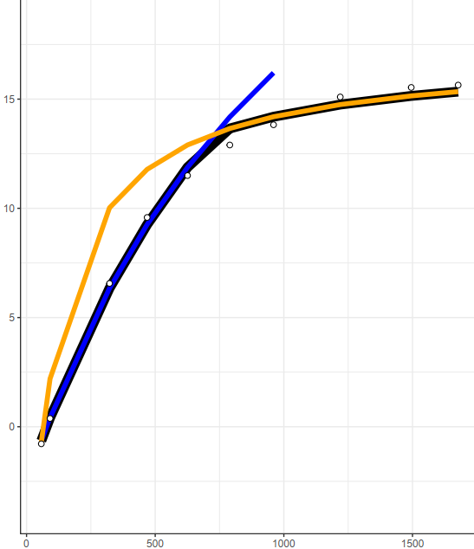

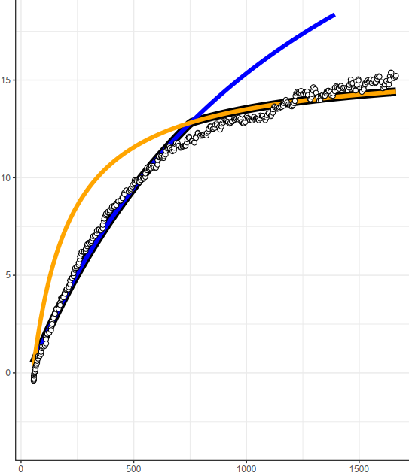
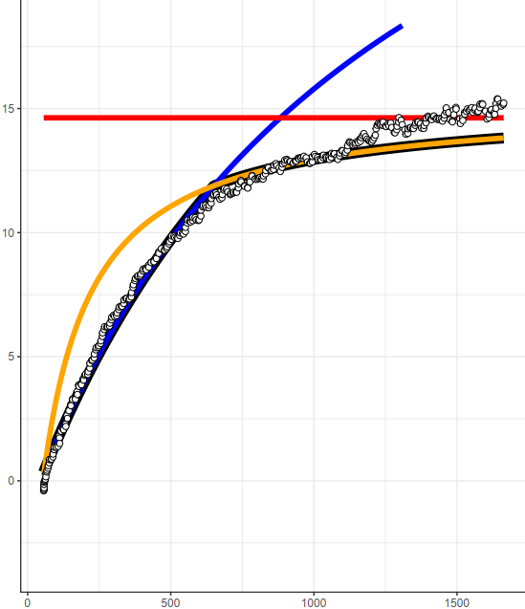
Abarema mataybifolia-1, Leaf 1
Without TPU
With TPU
Steady-State
Modeled A
DAT
Modeled A
$$C_{i}$$
$$C_{i}$$

Slide 7
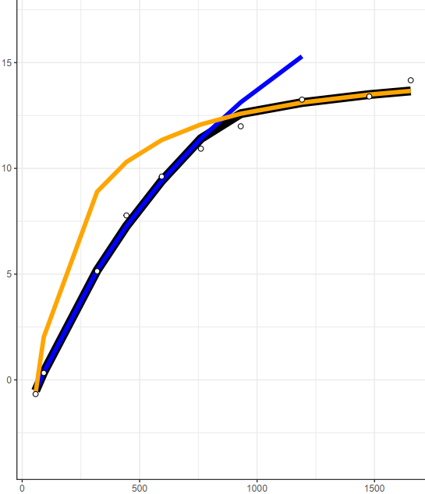

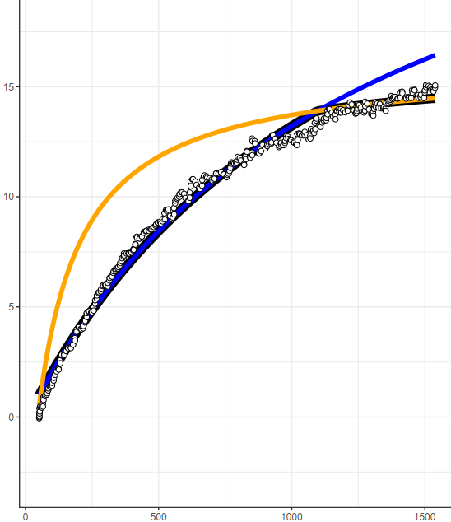
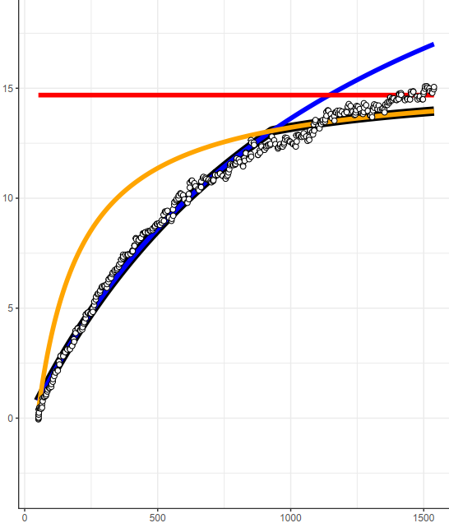
Abarema mataybifolia-1, Leaf 2
Without TPU
With TPU
Steady-State
Modeled A
DAT
Modeled A
$$C_{i}$$
$$C_{i}$$

Slide 8
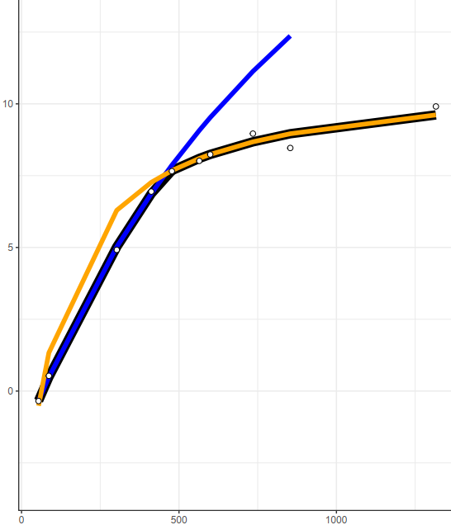
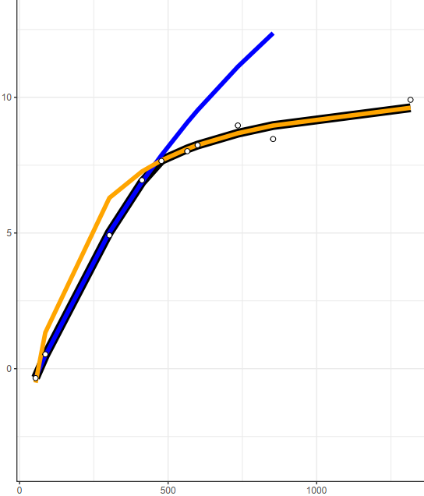
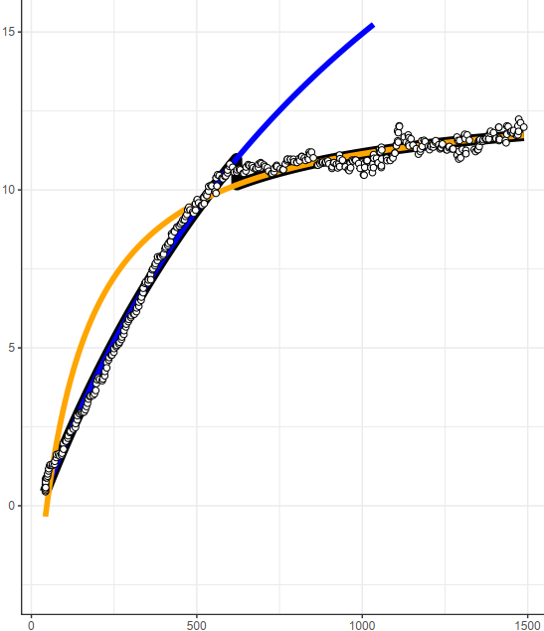
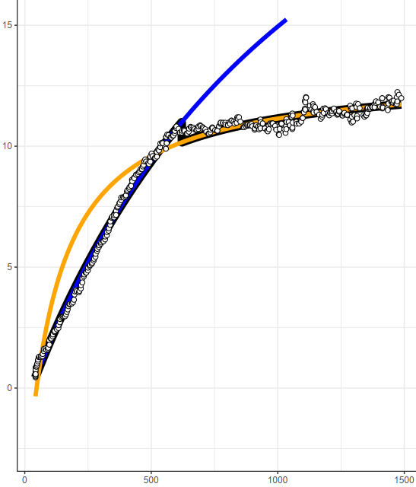
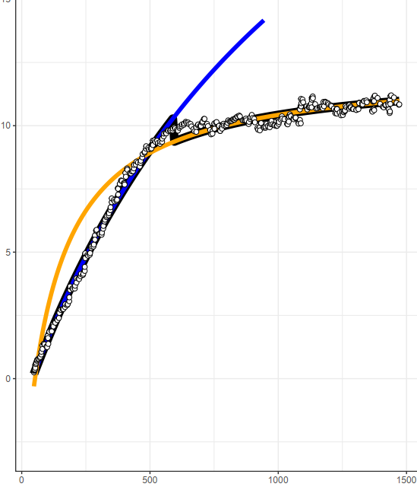



Protium apiculatum, Leaf 1
Without TPU
With TPU
Steady-State
Modeled A
Modeled A
DAT
Modeled A
$$C_{i}$$
$$C_{i}$$

Slide 9
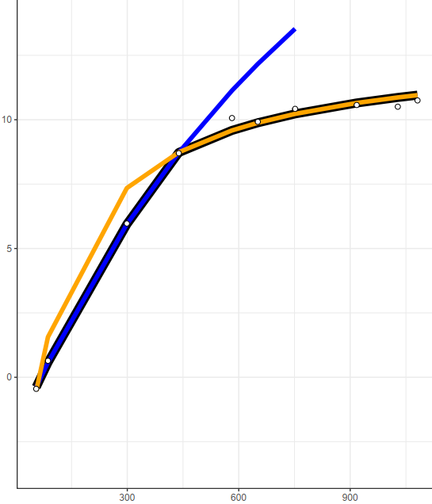
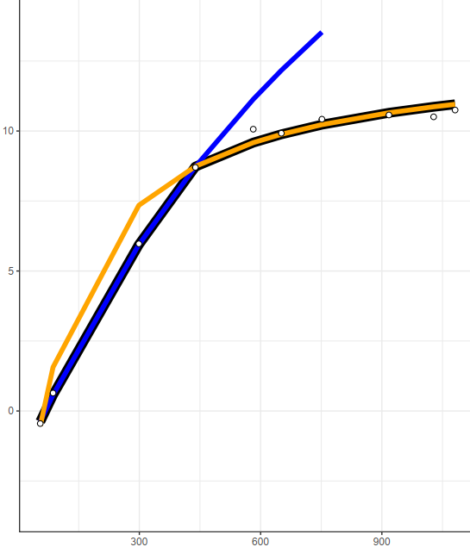
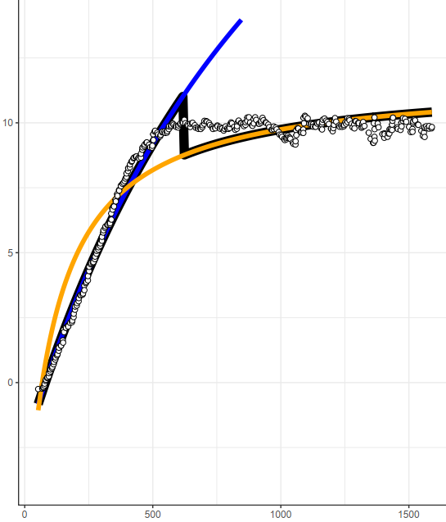
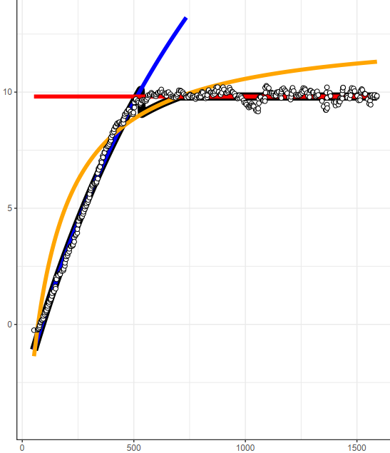
Protium apiculatum, Leaf 2
Without TPU
With TPU
Steady-State
Modeled A
DAT
Modeled A
$$C_{i}$$
$$C_{i}$$

Slide 10
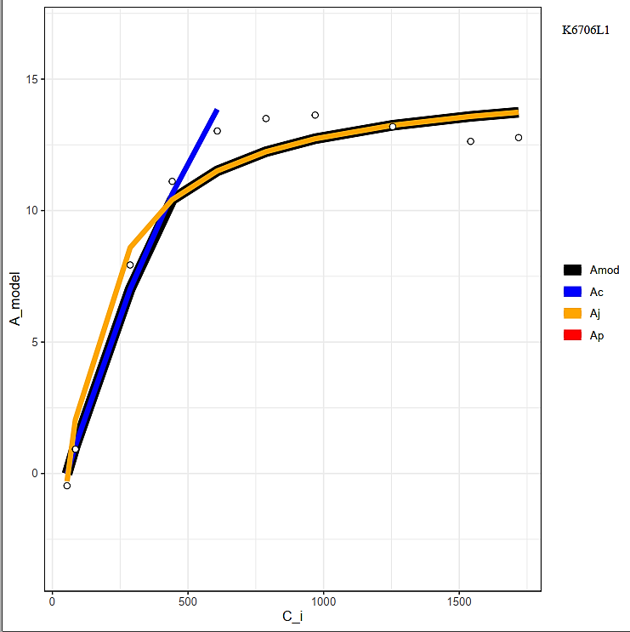
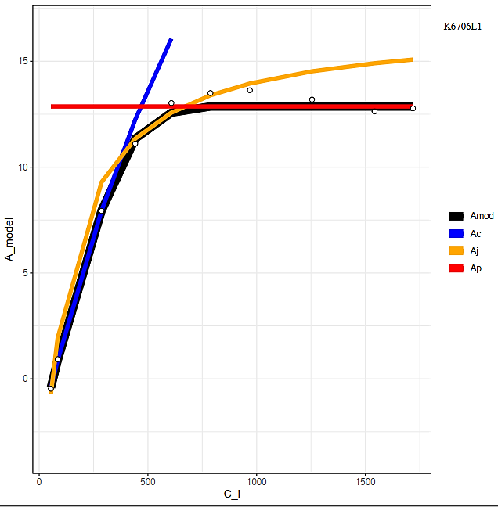
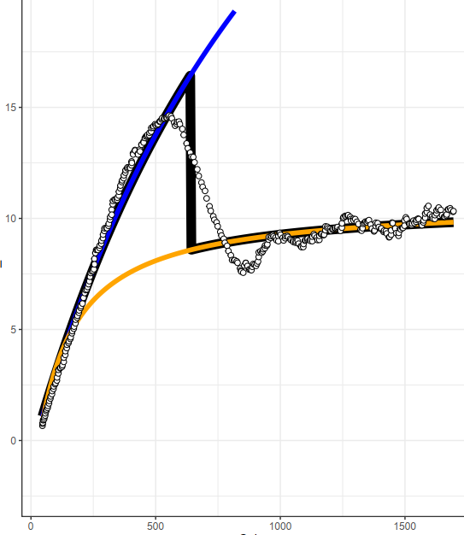
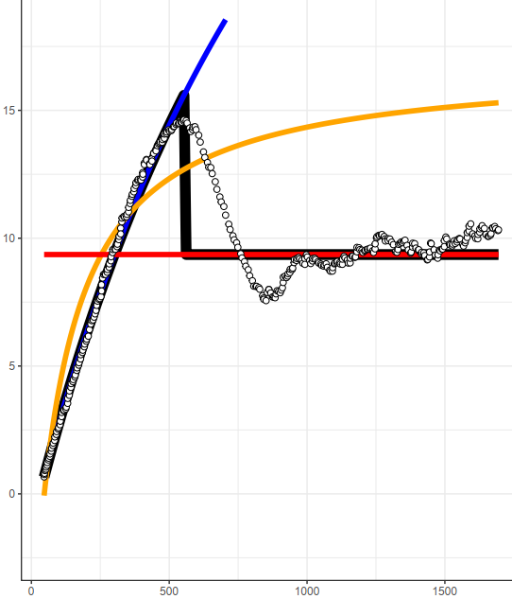
Eschweilera sp. trufle1, Leaf 1
Without TPU
With TPU
Steady-State
Modeled A
DAT
Modeled A
$$C_{i}$$
$$C_{i}$$

Slide 11
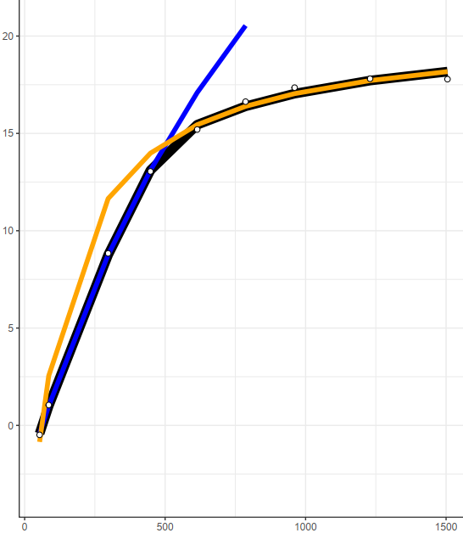
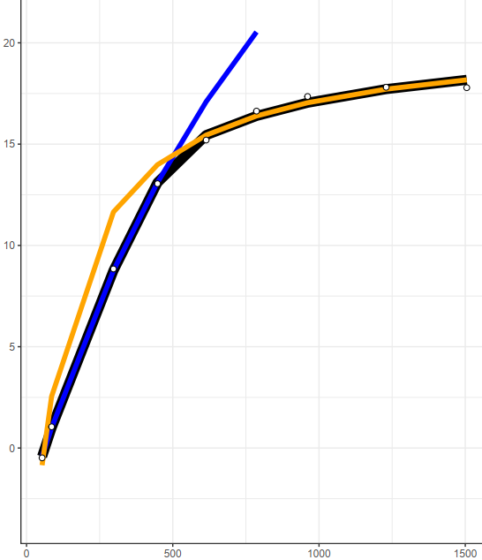
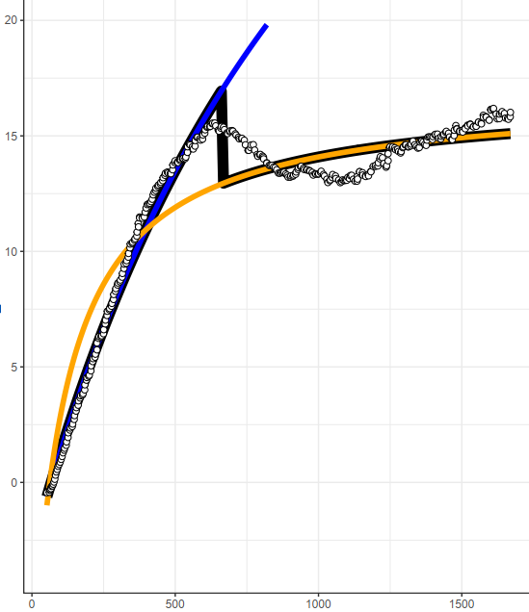
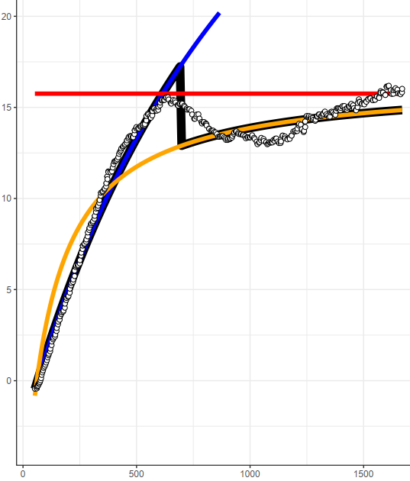
Eschweilera sp. trufle1, Leaf 2
Without TPU
With TPU
Steady-State
Modeled A
DAT
Modeled A
$$C_{i}$$
$$C_{i}$$

Slide 12
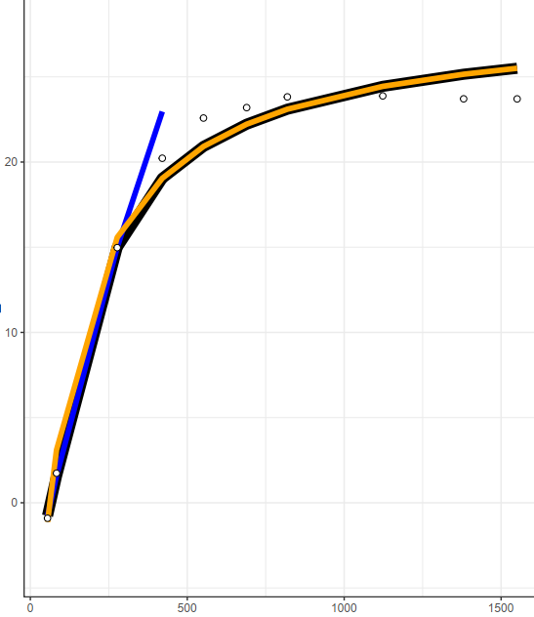
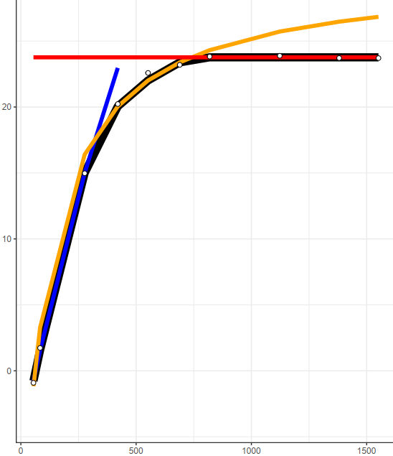
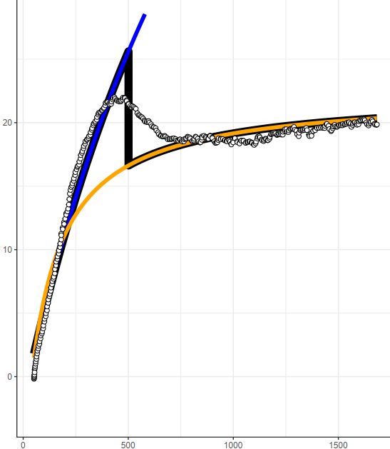
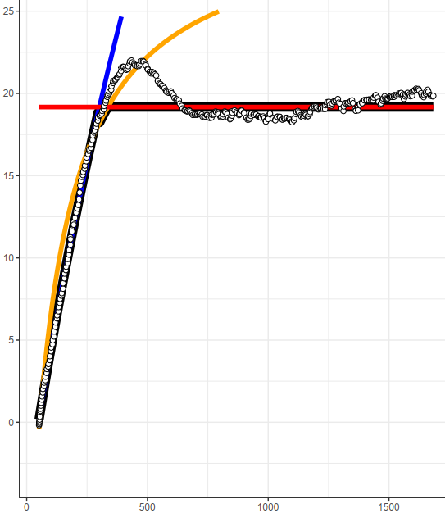
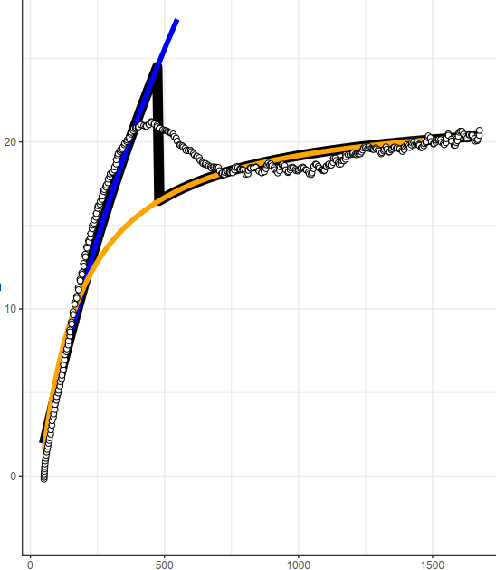
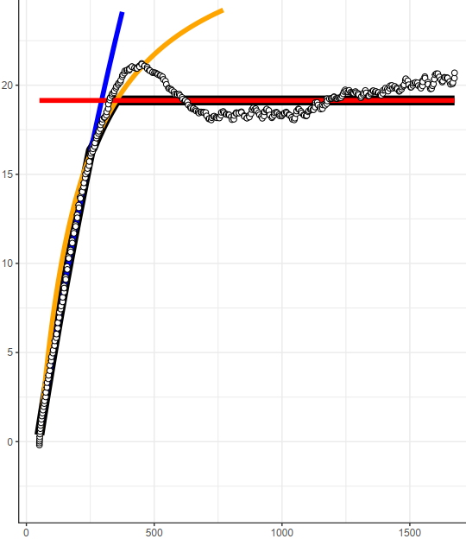


Tachigali chrysophylla, Leaf 1
Without TPU
With TPU
Steady-State
Modeled A
Modeled A
DAT
Modeled A
$$C_{i}$$
$$C_{i}$$

Slide 13
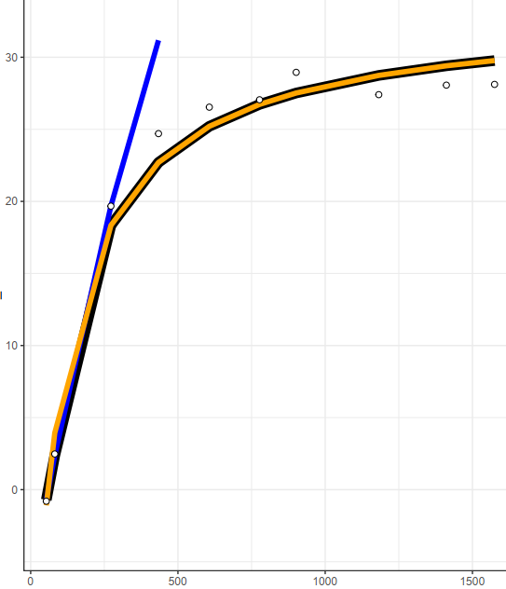
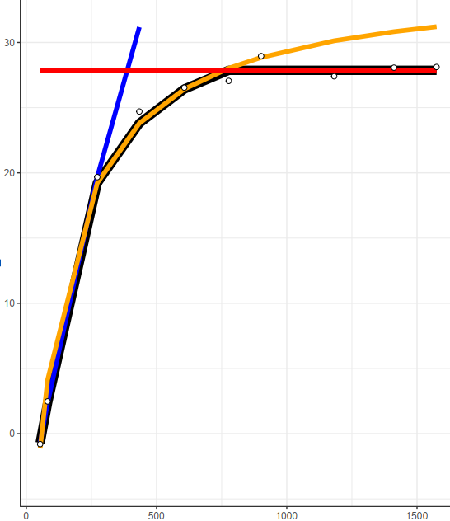
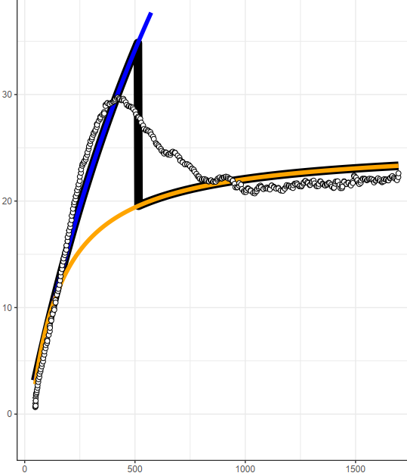
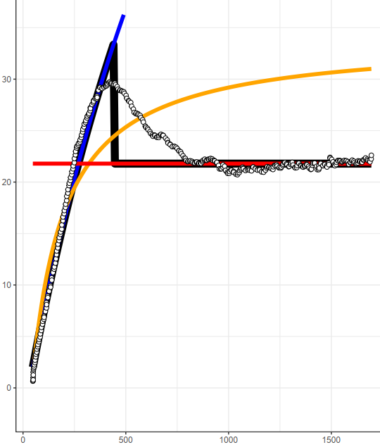
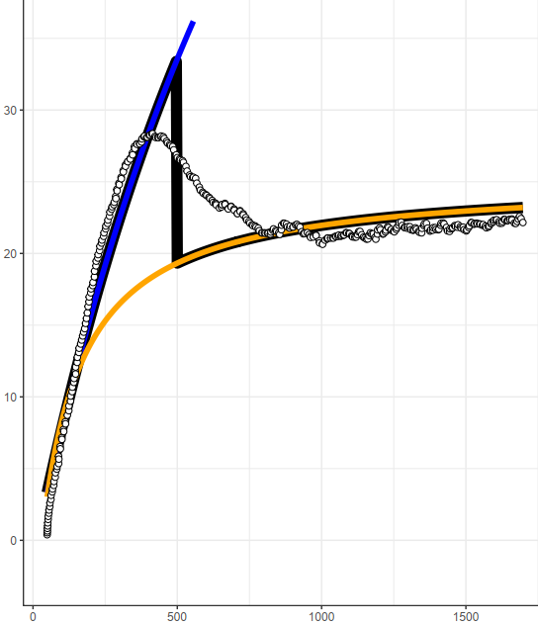
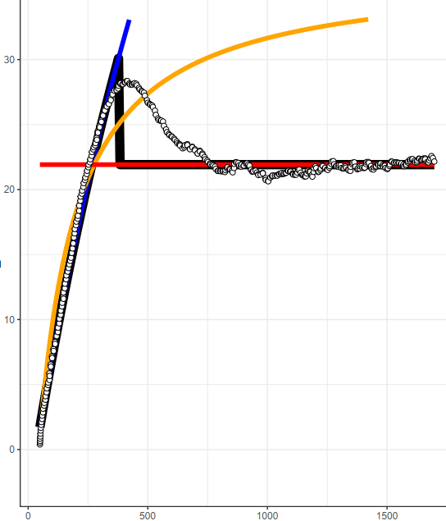
Tachigali chrysophylla, Leaf 2
Without TPU
With TPU
Steady-State
Modeled A
Modeled A
DAT
Modeled A
$$C_{i}$$
$$C_{i}$$

Slide 14
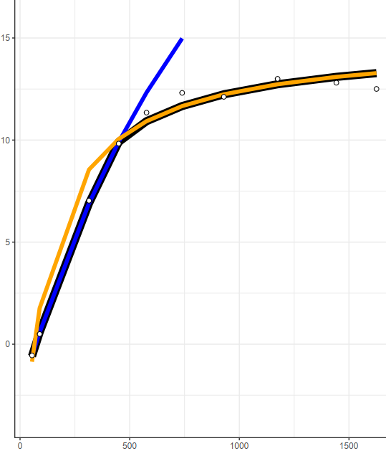

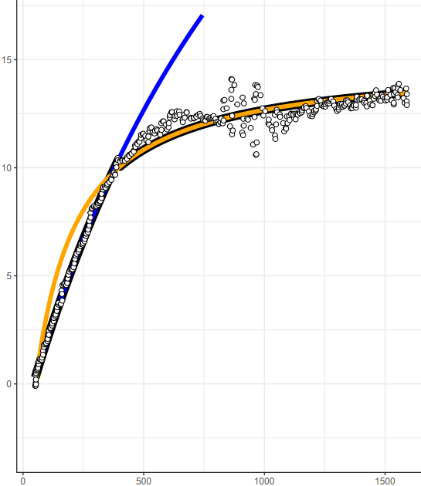
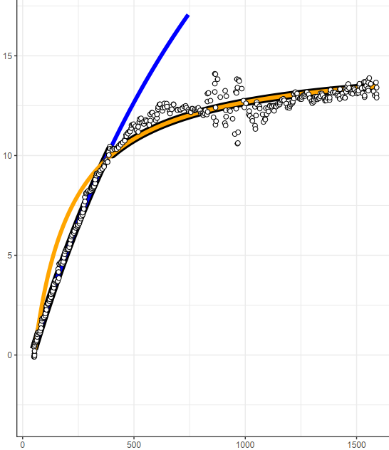
Chimarrhis turbinate, Leaf 1
Without TPU
With TPU
Steady-State
Modeled A
DAT
Modeled A
$$C_{i}$$
$$C_{i}$$

Slide 15
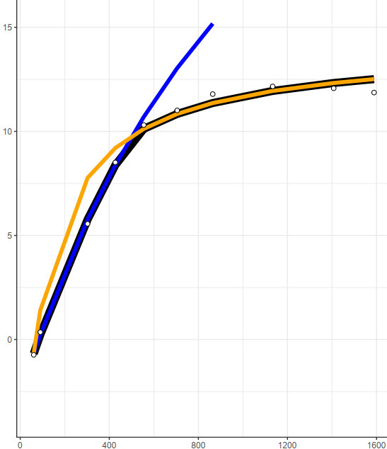
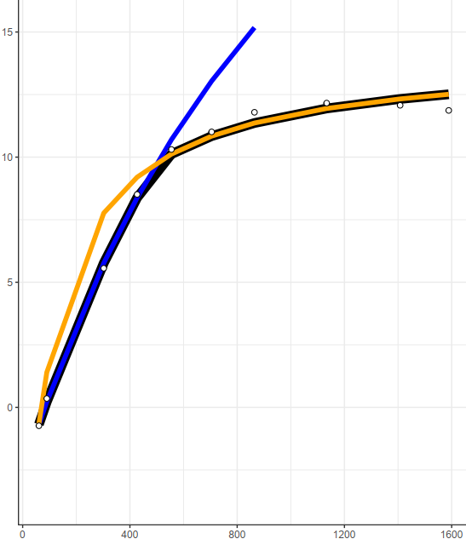


Chimarrhis turbinate, Leaf 2
Without TPU
With TPU
Steady-State
Modeled A
DAT
Modeled A
$$C_{i}$$
$$C_{i}$$

Slide 16






Manilkara elata, Leaf 2
Without TPU
With TPU
Steady-State
Modeled A
Modeled A
DAT
Modeled A
$$C_{i}$$
$$C_{i}$$

Slide 17




Manilkara elata, Leaf 3
Without TPU
With TPU
Steady-State
Modeled A
DAT
Modeled A
$$C_{i}$$
$$C_{i}$$

Slide 18




Manilkara elata, Leaf 6
Without TPU
With TPU
Steady-State
Modeled A
DAT
Modeled A
$$C_{i}$$
$$C_{i}$$

Slide 19




Manilkara elata, Leaf 8
Without TPU
With TPU
Steady-State
Modeled A
DAT
Modeled A
$$C_{i}$$
$$C_{i}$$

Slide 20




Vismia cayennensis, Leaf 1
Without TPU
With TPU
Steady-State
Modeled A
DAT
Modeled A
$$C_{i}$$
$$C_{i}$$

Slide 21




Vismia cayennensis, Leaf 2
Without TPU
With TPU
Steady-State
Modeled A
DAT
Modeled A
$$C_{i}$$
$$C_{i}$$

Slide 22




Vismia cayennensis, Leaf 3
Without TPU
With TPU
Steady-State
Modeled A
DAT
Modeled A
$$C_{i}$$
$$C_{i}$$

Slide 23




Anaxagorea dolichocarpa, Leaf 1
Without TPU
With TPU
Steady-State
Modeled A
DAT
Modeled A
$$C_{i}$$
$$C_{i}$$

Slide 24




Anaxagorea dolichocarpa, Leaf 2
Without TPU
With TPU
Steady-State
Modeled A
DAT
Modeled A
$$C_{i}$$
$$C_{i}$$

Slide 25






Coussarea paniculata, Leaf 1
Without TPU
With TPU
Steady-State
Modeled A
Modeled A
DAT
Modeled A
$$C_{i}$$
$$C_{i}$$

Slide 26




Coussarea paniculata, Leaf 2
Without TPU
With TPU
Steady-State
Modeled A
DAT
Modeled A
$$C_{i}$$
$$C_{i}$$

Slide 27




Miconia egensis, Leaf 1
Without TPU
With TPU
Steady-State
Modeled A
DAT
Modeled A
$$C_{i}$$
$$C_{i}$$

Slide 28




Miconia egensis, Leaf 2
Without TPU
With TPU
Steady-State
Modeled A
DAT
Modeled A
$$C_{i}$$
$$C_{i}$$

Slide 29




Aparisthmium cordatum, Leaf 1
Without TPU
With TPU
Steady-State
Modeled A
DAT
Modeled A
$$C_{i}$$
$$C_{i}$$

Slide 30




Aparisthmium cordatum, Leaf 2
Without TPU
With TPU
Steady-State
Modeled A
DAT
Modeled A
$$C_{i}$$
$$C_{i}$$

Slide 31




Abarema mataybifolia-2, Leaf 1
Without TPU
With TPU
Steady-State
Modeled A
DAT
Modeled A
$$C_{i}$$
$$C_{i}$$

Slide 32




Abarema mataybifolia-2, Leaf 2
Without TPU
With TPU
Steady-State
Modeled A
DAT
Modeled A
$$C_{i}$$
$$C_{i}$$

